Slide 1
Web Development 101
A guide by <Rathesh Prabakar>

Slide 2
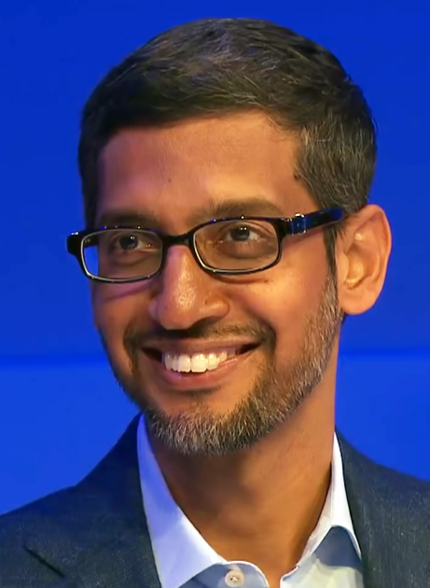
Self explosion
“Let yourself feel insecure from time, It will help you grow as an individual.”
― Sundar Pichai

Slide 3


1. Agenda
Overview
Front end vs Back end.
Dive into front end Highlight what’s new, tips, tools and frameworks.
Ocean of back end Give people a method to swim.
Connecting the web Provide an unifying information for what is web and how it works.

Slide 4
Front End Vs Back End
Me : What’s in your screen ?
You : What’s happening behind your screen ?
Fact
Catchy UI Catches people.
If front end is a heart, then backend is a brain.

Slide 5
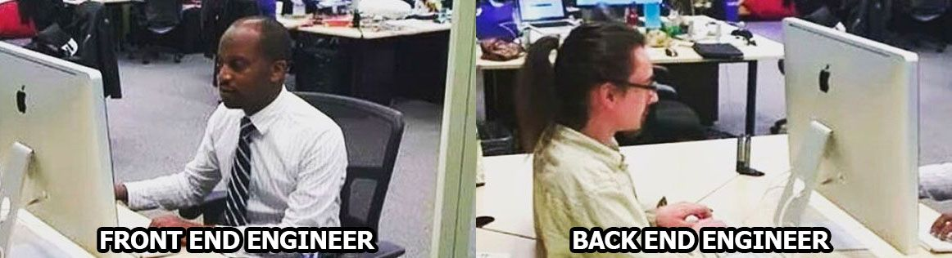

Slide 6
How many languages do you need to know to communicate with Web users?
Fact
HTML : Organizer
CSS : Stylist
JS : Multitasker

Slide 7
Just one! Your favorite.
React JS
Angular JS
Vue JS
Tips
Use Reddit channels
Read Mozilla docs
Educative.io
Frontend masters
Practice @freecodecamp

Slide 8

The logical area which enlighten the functionality of front end : Back end
Fact
Back end developer is so hot in the market, Highly paid job,
Front end + Back end = Full Stack

Slide 9
Components of Back end
Database Language
MySQL
SQLlite
Hybernite
PostgreSQL
Server Language
PHP
Python
Java
Ruby
Perl
Server Framework
Laravel
Django, Flask
Spring
Ruby On Rails

Slide 10
Web Browser Vs Web Server
Chrome : I am the one who shows all the data.
Localhost : I am the one who processes the data.
Tips
While running localhost, use Incognito window.
Use client side for lighter process.

Slide 11
Short Tips
Front end Github Education Pack
Freecodecamp (Responsive Web Design)
Back end Documentation, Reddit
Search on Medium (Projects)

Slide 12

QUERIES ??

Slide 13





Let’s Chat :
: Rathesh Prabakar
: www.ratheshprabakar.tech
: ratheshprabakar@gmail.com
: ratheshprabakar

